Slide 1
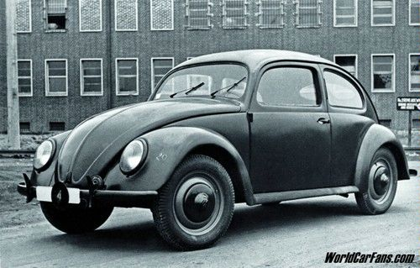
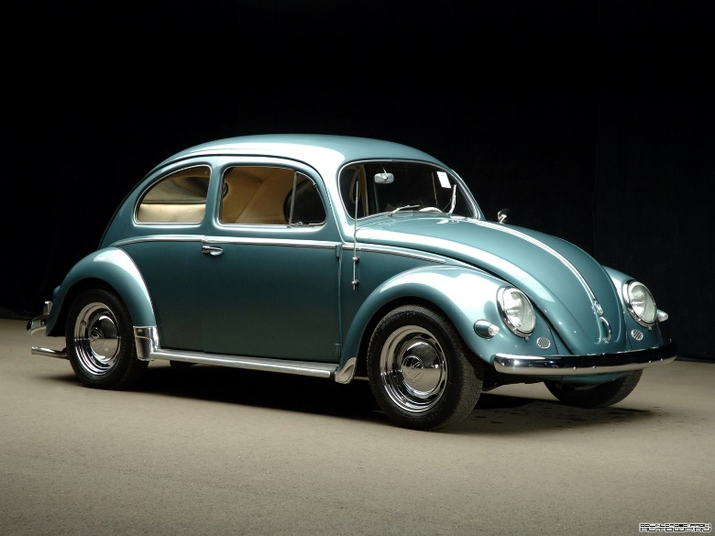
The VW Beetle
Cesar Reis Leiva

Slide 2
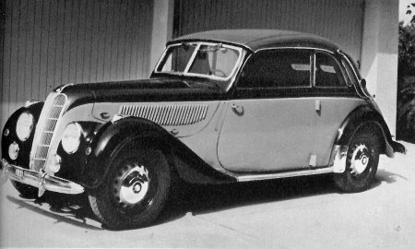
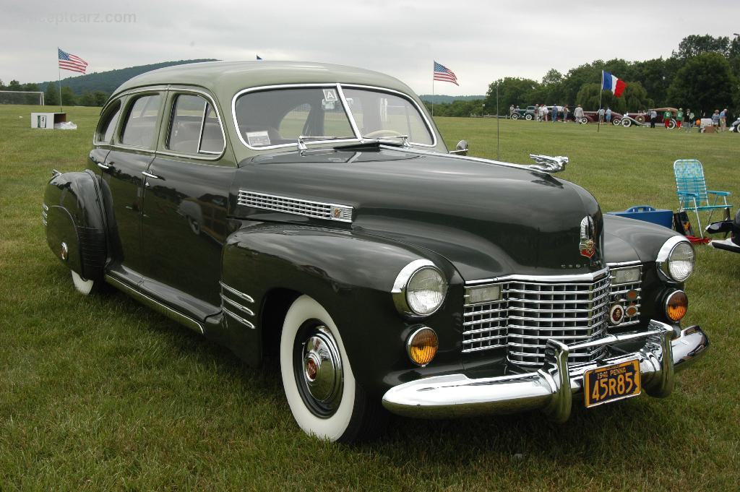
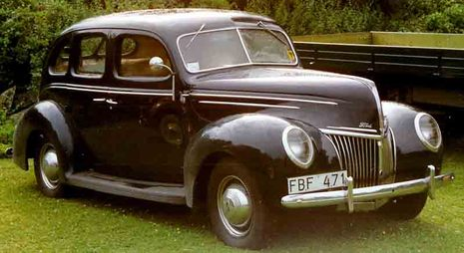
Why the VW Beetle?
Historical Relevance
→ 1939 – 1945 : During the WWII, the automobile industry was composed only by cars such as the BMW 335, the Cadillac Series 61 and the Ford Model 91, which most of the population didn’t had access to.
BMW 335
Cadillac series 61
Ford Model 91

Slide 3
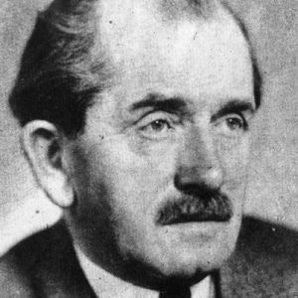
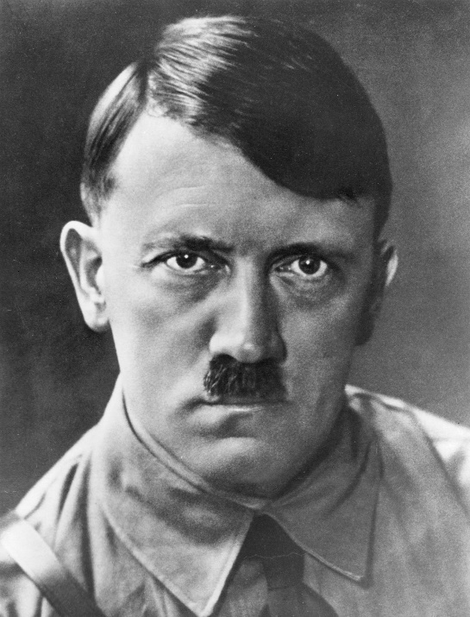
The VW Beetle was designed by Ferdinand Porsche under the requirements of Hitler.
The requirements were:
Cheap
Easily manufactured
Big enough to fit a family of five
Have an Air-cooled engine

Slide 4
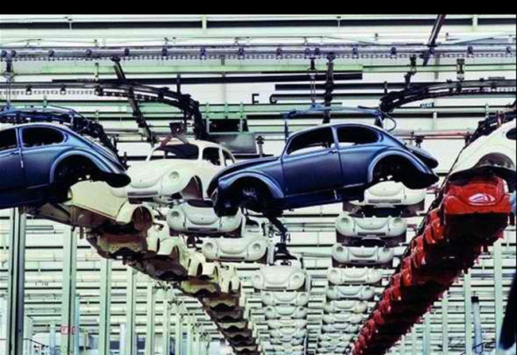
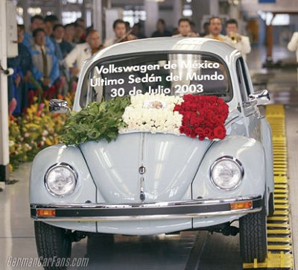
1938: more than 170,000 cars had been ordered
1949: VW was Germany’s major manufacturer because of the Beetle
1954: One million cars produced mark achieved
2003: Last Beetle, produced in Puebla, Mexico.

Slide 5
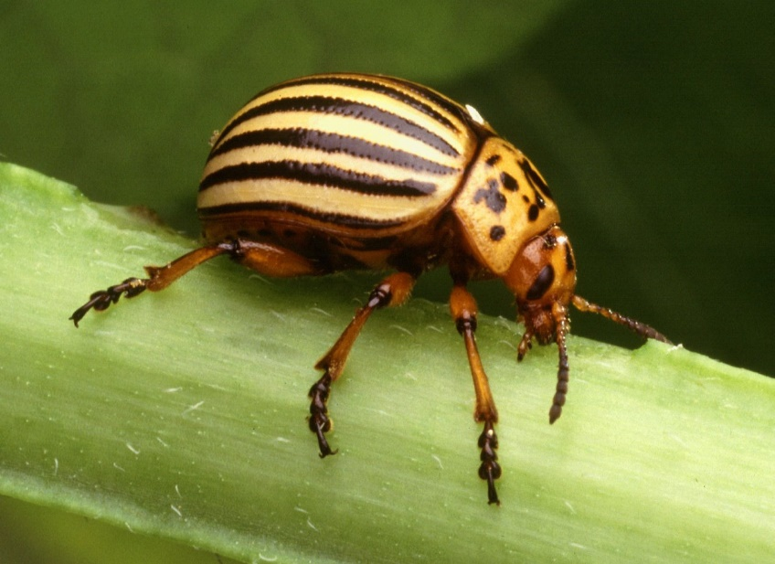
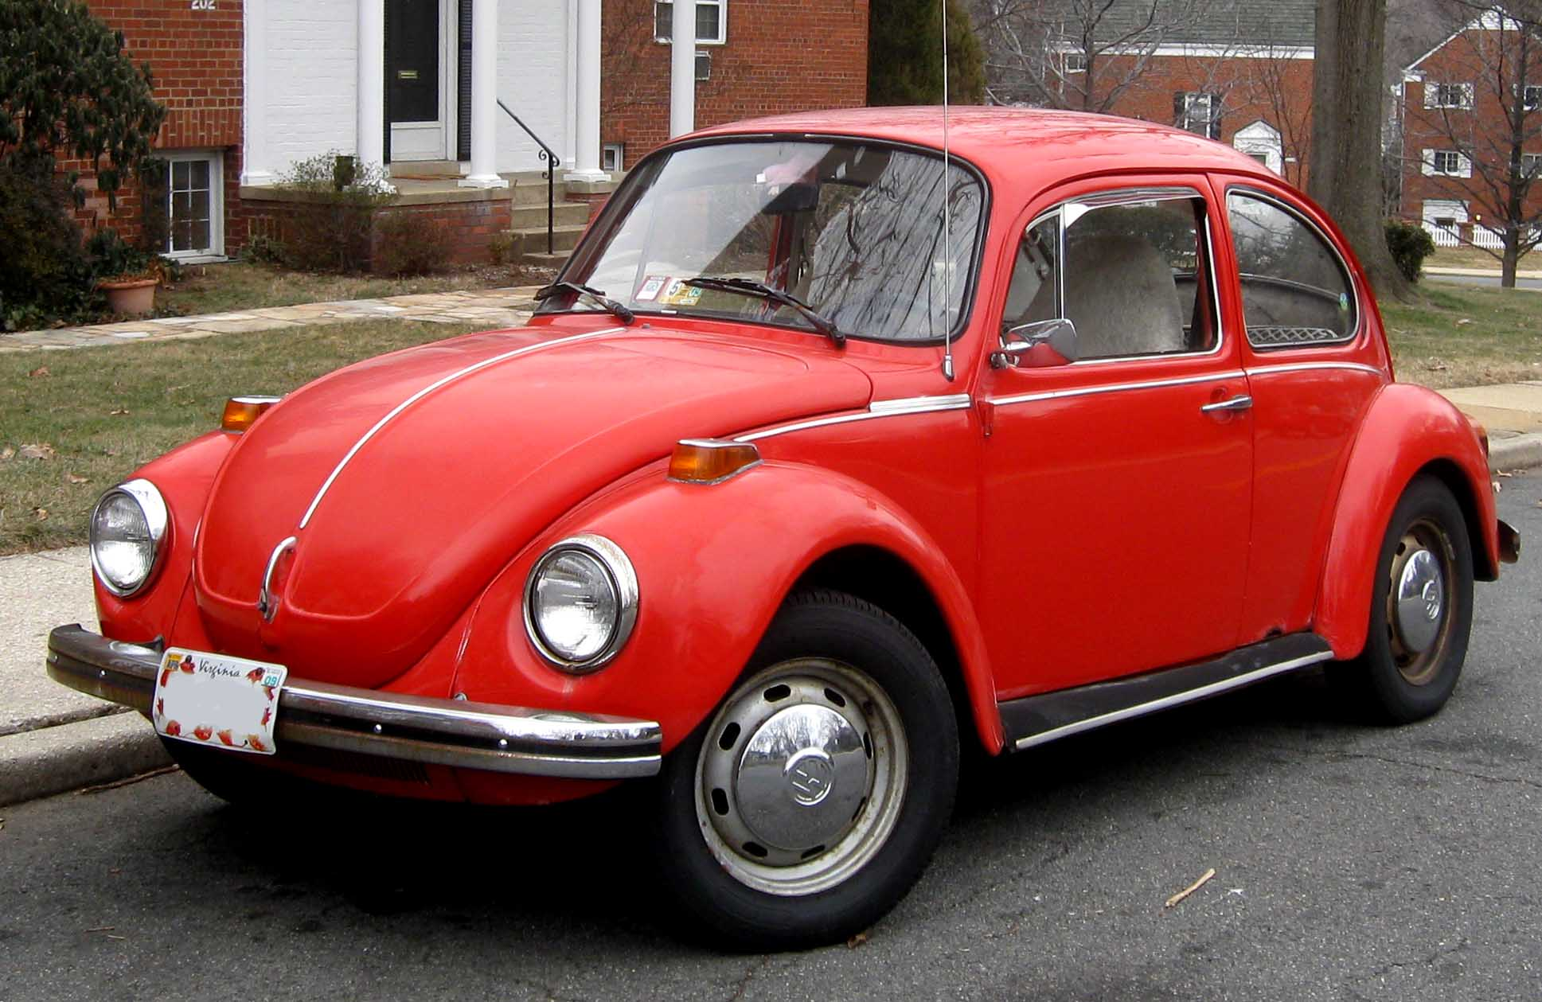
THE BODY
By building a body with the shape similar to a Beetle for a better streamline and aerodynamics, the VW Beetle became one of the first examples of Biomimicry Engineering

Slide 6
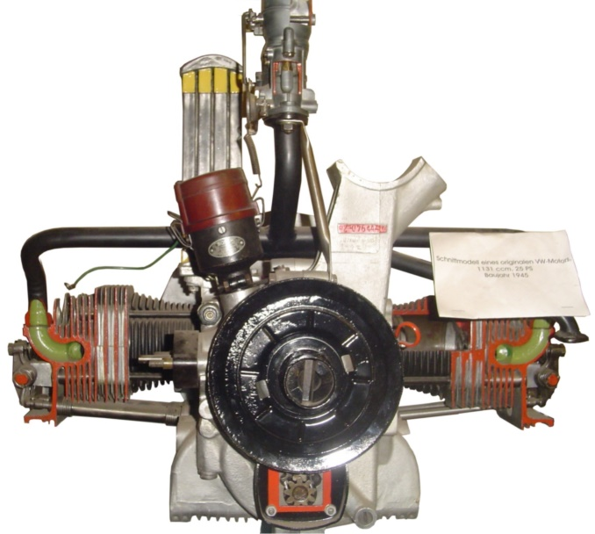
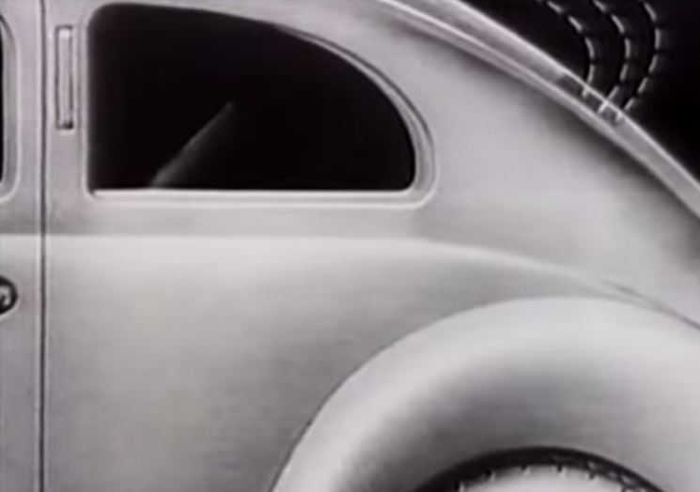
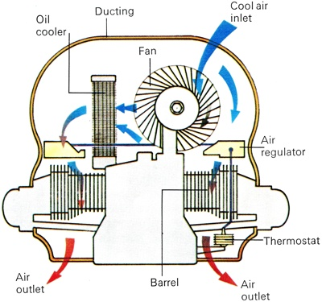
THE ENGINE
The first VW Beetle engine was an e-motor: a four cylinder, air-cooled, 1.1 cc boxer engine with the 24 BHP
The Horizontal placement of the cylinders in the Boxer Engine and the Air-Cooled property of it resulted in a small, cheap, reliable engine that fitted Hitler’s requirements
The last boxer engine to equip the VW Beetle (with 1.6 cc) had astounding 54 BHP and Electronic Fuel Injection ( introduced in 1968 )

Slide 7
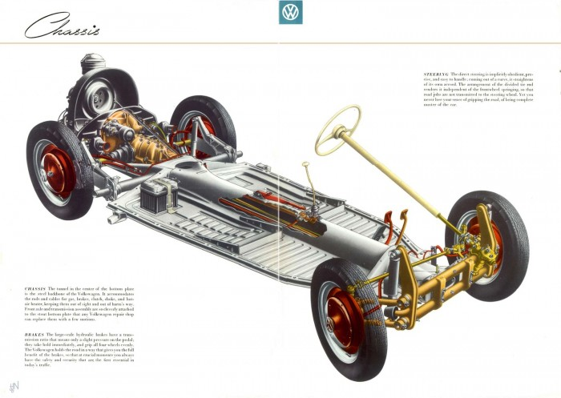
THE CHASSIS
The VW Beetle’s chassis was the same as the Kübelwagen, a military vehicle also designed by Ferdinand Porsche.
This chassis is a Back-Bone/Ladder type, which allowed a quick and cheap manufacturing process.

Slide 8
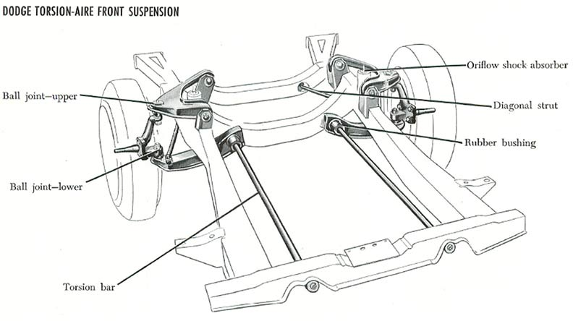
THE SUSPENSION
The VW Beetle is equipped with an Torsion Bar Suspension.
This suspension has a high-durability, it’s easy to regulate, cheap and requires less space then the Spring Suspension

Slide 9
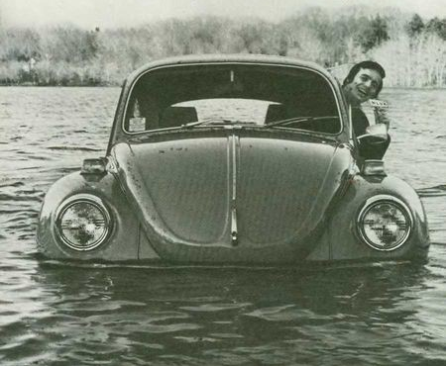
IT FLOATS!

Slide 10
Is the VW Beetle the best car?
NO!

Slide 11
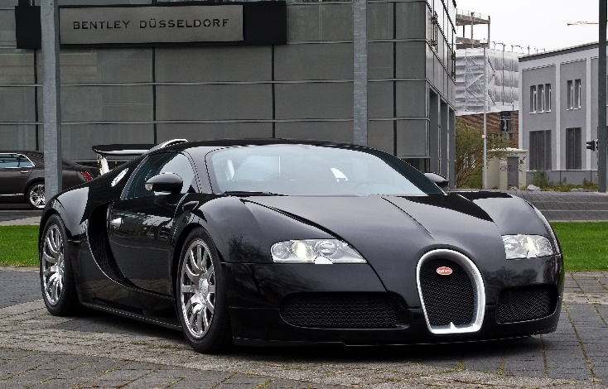
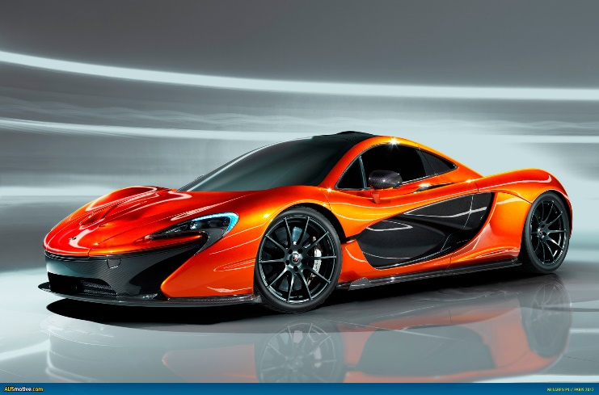
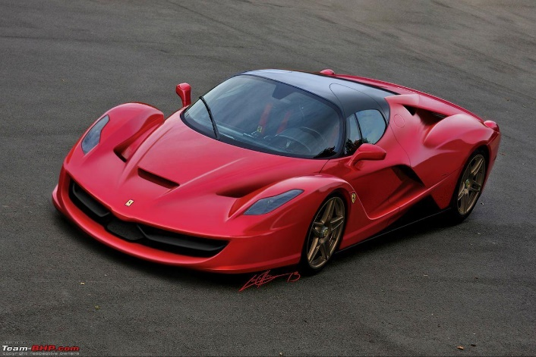
The VW Beetle is not the fastest car, nor the prettiest.
Its horse power is nothing compared to the Bugatti Veyron (1244 BHP), or the McLaren P1 (903 BHP), or the Ferrari Laferrari (950 bhp)

Slide 12
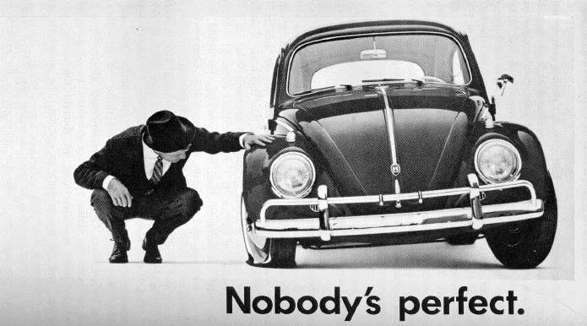
So… why did I choose this car?

Slide 13
Thank you

